Slide 1
WISPR
Team Rocket Lee Klarich, William Holley, Jawad Usman, Sydney Mathis Adams

Slide 2
Description
WISPR is an application that utilizes RSA encryption to allow users to message each other with maximum security. The app focuses on its small size and portability to deliver a safe way to host or join a chat room.
It was designed with a general audience in mind, and is a multi use application for communication.
RSA encryption utilizes a mathematical formula to create an asymmetric algorithm.

Slide 3
User guide
To use Wispr, open the app and either type in your username and password or create a new account. Choose a chat room to join, and begin sending messages. To create an account, click the create an account button, then enter a username and desired password. This creates a new user in the database and logs them in. To login as a registered user, enter your username and password. If they are correct, the information passes the check and continues to the app. If not, an error is thrown and the user is prompted to try again. Select a server by clicking on a button next to one of the server names. In the chat screen, type a message in the bar and click send to post it into the server. Existing login credentials are: username – user, password – yes.

Slide 4
RTM
Entry # | Paragraph # | System Specification Text | Type | Build | Use Case Name
1 | 1.0 | Shall contain a space to enter your username. | SW | B1 | Login Page
2 | 1.0 | Shall contain a button to host server. | SW | B1 | Login Page
3 | 1.0 | Shall contain button to join server. | SW | B1 | Host Page
4 | 1.0 | Shall contain multiple windows to serve different purposes. | SW | B1 | Main GUI
5 | 1.0 | Shall contain a space to enter plaintext. | SW | B1 | Host Page
6 | 1.0 | Shall contain a window to view plaintext sent and received. | SW | B1 | Host Page
7 | 1.0 | Shall contain a "Send" button to initiate encryption and transmit encrypted content to client. | SW | B1 | Host Page
8 | 3.0 | Shall encrypt plaintext. | SW | B3 | Encryption
9 | 2.0 | Shall send encrypted text to client. | SW | B2 | Encryption
10 | 4.0 | Shall include date/time of transmission. | SW | B4 | Encryption
11 | 3.0 | Shall store information in a database for logging (proof of encryption). | SW | B3 | Database
12 | 3.0 | Shall recieve encrypted text. | SW | B3 | Encryption
13 | 3.0 | Shall decrypt encrypted text. | SW | B3 | Encryption
14 | 1.0 | Shall post plaintext in window. | SW | B1 | Host Page
15 | 4.0 | Shall contain Plaintext, Date/Time, and Username of Sender. | SW | B4 | Host Page
16 | 2.0 | Shall contain "End" button that closes the application. | SW | B2 | Main GUI
17 | 3.0 | Shall print out contents from the database onto the console (encrypted chat log). | SW | B3 | Console
18 | 4.0 | Shall be able to add friends by username. | SW | B4 | Database
19 | 4.0 | Shall be able to remove friends by username. | SW | B4 | Database

Slide 5
Requirements Elicitation

Slide 6
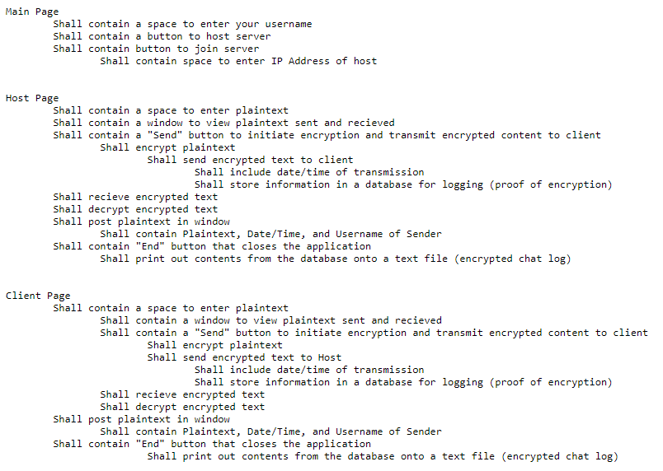

Slide 7
Design Process
Our design went through one major point of change, this was to reflect a change in the needs of the client. Between the first and second build the design went from an inter-company product to a generalized product.
This changed the client from a specific company to the general public.
The design was also changed through the type of encryption chosen. The end result chosen was RSA encryption. It is typically a slower encryption method, however it is a very secure way to encrypt information and suited the communication style of application we wanted to develop.

Slide 8
COCOMO
Cost Drivers |  |  | Ratings
 | Very Low | Low | Nominal | High | Very High | Extra High
Product Attributes
Required Software Reliability | 0.75 | 0.89 | 1.00 | 1.14 | 1.40
Database Size |  | 0.90 | 1.00 | 1.09 | 1.15
Product Complexity | 0.70 | 0.78 | 1.00 | 1.14 | 1.29 | 1.60
Hardware Attributes
Run Time Constraints |  |  | 1.00 | 1.14 | 1.29 | 1.66
Memory Constraints |  |  | 1.00 | 1.10 | 1.30 | 1.65
Virtual Machine Volatility |  | 0.85 | 1.00 | 1.07 | 1.15
Turnaround Time |  | 0.85 | 1.00 | 1.08 | 1.20
Personnel Attributes
Analyst Capability | 1.45 | 1.18 | 1.00 | 0.89 | 0.72
Applications Experience | 1.20 | 1.18 | 1.00 | 0.86 | 0.79
Virtual Machine Experience | 1.49 | 1.19 | 1.00 | 0.92 | 0.82
Programming Language Experience | 1.45 | 1.10 | 1.00 | 0.94
Project Attributes
Modern Programming Practices | 1.25 | 1.10 | 1.00 | 0.91 | 0.85
Use of Software Tools | 1.21 | 1.12 | 1.00 | 0.90 | 0.83
Required Development Schedule | 1.23 | 1.10 | 1.00 | 1.10 | 1.03

